Slide 1
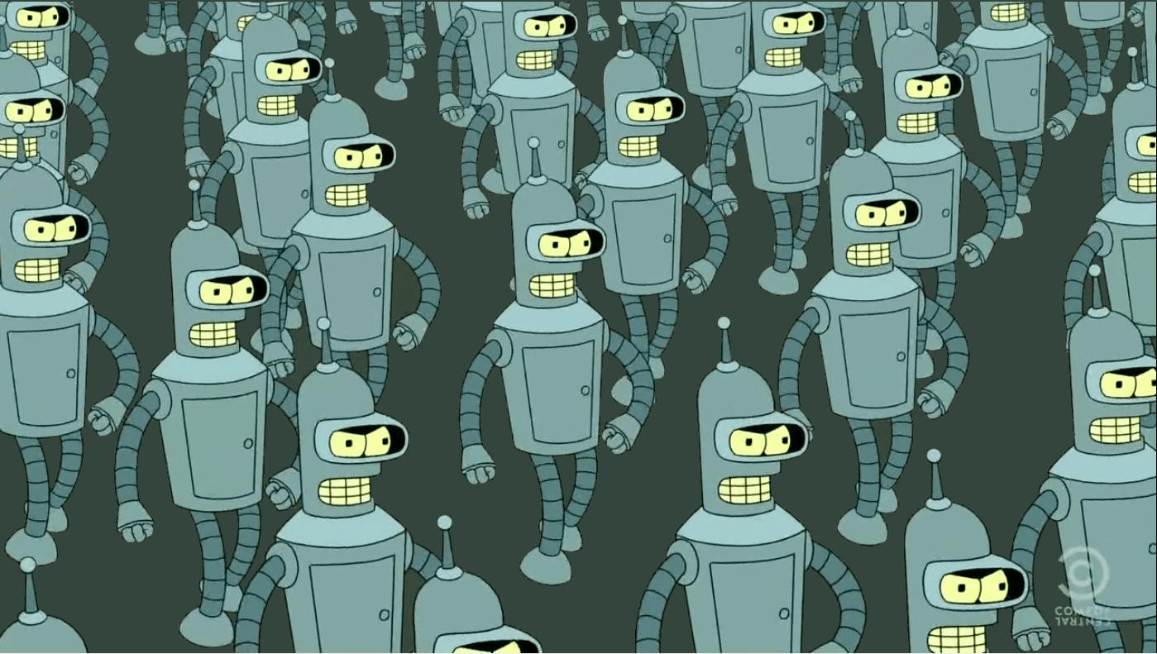
Deduplication of large amounts of code
Romain Keramitas
FOSDEM 2019

Slide 2
Clones
def foo(name: str):
print('Hello World, my name is ' + name)
def bar(name: str):
print('Hello World, my name is {}'.format(name))
def baz(name: str):
print('Hello World, my name is %s' % name)

Slide 3
Natural language clones
I am so happy to speak at FOSDEM this year
since it's a really awesome conference !
I will be speaking at FOSDEM this year, it makes me so happy
because that conference is really awesome !

Slide 4
Natural language clones
I am delighted to speak at FOSDEM this year
since it's a really amazing conference !
I will be speaking at FOSDEM this year, it makes me so happy
because that conference is really awesome !

Slide 5
Clone Taxonomy (Kapser; Roy and Cordy )
Type I : exactly the same
Type II : structurally the same, syntactical differences
Type III : combination of type I & II and minor structural changes
Type IV : semantically the same, different structure and syntax

Slide 6
Type IV clone
def foo(n: int):
k = 0
for i in range(n):
k += i
return k
def bar(m: int):
counter, l = 0, 0
while counter < m:
counter += 1
l+= counter
return l

Slide 7
Déjà Vu approach (Lopes et al.)
def foo(n: int):
k = 0
for i in range(n):
k += i
return k
File hash
7d02b25e38eadb33e9f96d771e1844a6
Token hash
f2ea1bb5a6208b5d4f2c930a0d7042d6
[(def, 1), (foo, 1), (n, 2), (int, 1), (k, 3), (0, 1), (for, 1), (i, 2), (in, 1),
(range, 1), (return, 1)]
SourcererCC

Slide 8
Gemini approach
1. Extract syntactical and structural features from each snippet
Features Matrix M:
N x M values
M_{i,j} = importance of feature j
for snippet i (0 if none)
Dataset
N snippets

Slide 9
Gemini approach
2. Create a pairwise similarity graph between snippets,
by hashing the feature matrix
Pairwise Similarity Graph
Graph with N nodes
nodes = snippets
edge = similarity
Dataset
N snippets
Features
NxM values

Slide 10
Gemini approach
3. Extract connected components from the similarity graph
Connected Components
Graphs where each pair of nodes is connected by paths
Dataset
N snippets
Features
NxM values
Similarity Graph
N nodes

Slide 11
Gemini approach
4. Perform community detection on each components to obtain
clone communities
Clone
Communities
Parts of components where each node is a clone
Dataset
N snippets
Features
NxM values
Similarity Graph
N nodes
Connected
Components

Slide 12
Feature Extraction Step
Dataset
N snippets
Features
NxM values
Similarity Graph
N nodes
Connected
Components
Clone
Communities

Slide 13
Abstract Syntax Trees
def
def foo(x):
return x + 42
foo
x
return
+
x
42

Slide 14
Abstract Syntax Trees
def(decl)
def foo(x):
return x + 42
foo(id)
x(id)
return(stat)
+(op)
x(id)
42(lit)

Slide 15
Identifiers and Literals
def foo(n: int):
k = 0
for i in range(n):
k += i
return k + 42
Identifiers:
[(foo, 1),(n, 2),(k, 3),(i, 2)]
Literals:
[(0, 1), (42, 1)]

Slide 16
Graphlets and Children
def(decl)
Graphlets:
[(decl,[id,id,statement]),
(id, []),(id, []),
(statement,[op.]),(op,[id,lit])
(id,[]),(lit,[])]
foo(id)
x(id)
return(stat)
+(op)
Children:
[(decl,3), (id, 0),(id, 0),
(statement,1),(op,2)(id,0),
(lit,0)]
x(id)
42(lit)

Slide 17
Graphlets and Children
Graphlets:
[((decl,[id,id,statement]),1),
((id, []),3),
((statement,[op.]),1)
((op,[id,lit]),1),((lit,[]),1)]
def
foo
x
return
Children:
[((decl,3),1),((id, 0),3),
((statement,1),1),((op,2),1),
((lit,0),1)]
+
x
42

Slide 18
TF-IDF
w_{x,y} = tf_{x,y} × log ( N / df_{x} )
tf_{x,y} = frequency of feature x in snippet y
df_{x} = number of snippets containing feature x
N = total number of snippets

Slide 19

Feature extraction step
1. Convert snippets to UAST using Babelfish
2. Extract weighted bags of features from each UAST
3. Perform TF-IDF to reduce the amount of features
4. Find weights for each feature type (hyperparameters)

Slide 20
Hashing Step
Dataset
N snippets
Features
NxM values
Similarity Graph
N nodes
Connected
Components
Clone
Communities

Slide 21
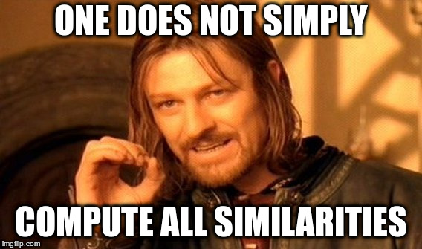

Slide 22
Similarity between weighted bags ?
Problem: Computing similarity between each pair of snippet
is not viable
1 million snippets 499,998,500,001 similarities
428 million snippets 91,591,999,358,000,000 similarities

Slide 23
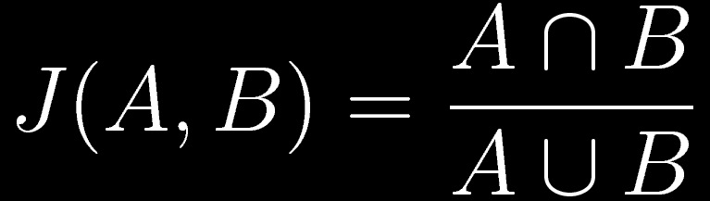

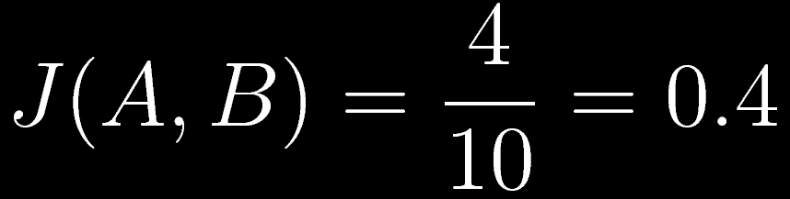
Weighted Jaccard Similarity
S = set of all features
A , B = subsets of S

Slide 24
Minhashing
1. Create perm(A) and perm(B)
2. Hash all elements in perm(A) and perm(B)
3. Select the smallest hash for A and B
4. Probability it's the same value equals J(A, B) !

Slide 25
Minhash signatures
We take the k smallest hash values for each snippet:
For each pair of snippets, the probability they have the same value in any row is still equal to their Jaccard similarity !
...
1 0 0 0 2
3 2 1 2 3
5 6 3 6 4
...
...
...
...
k rows
...
...
...

Slide 26
Locality-Sensitive Hashing
We divide the signature matrix into b bands of r rows
candidate pair = any snippets which have the same values in at least one band.
...
1 0 0 0 2
3 2 1 2 3
5 6 3 6 4
...
r rows
...
...
...
r × b = k rows
...
...
...

Slide 27
Locality-Sensitive Hashing
s = similarity between the two snippets
1. Probability the signatures are the same in one band: s^{r}

Slide 28
Locality-Sensitive Hashing
s = similarity between the two snippets
1. Probability the signatures are the same in one band: s^{r}
2. Probability the signatures are different in one band: 1 - s^{r}

Slide 29
Locality-Sensitive Hashing
s = similarity between the two snippets
1. Probability the signatures are the same in one band: s^{r}
2. Probability the signatures are different in one band: 1 - s^{r}
3. Probability the signatures are different in all bands: (1 - s^{r})^{b}

Slide 30
Locality-Sensitive Hashing
s = similarity between the two snippets
1. Probability the signatures are the same in one band: s^{r}
2. Probability the signatures are different in one band: 1 - s^{r}
3. Probability the signatures are different in all bands: (1 - s^{r})^{b}
4. Probability the signatures are the same in at least one band,
i.e. the snippets are a candidate pair: 1 - (1 - s^{r})^{b}

Slide 31
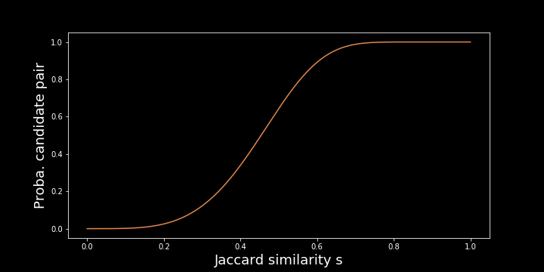
Locality-Sensitive Hashing
Regardless of r and b, we get an S-curve:

Slide 32
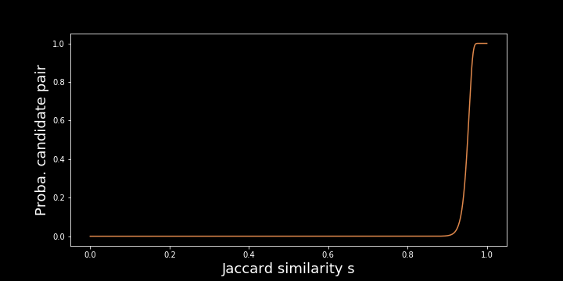
Locality-Sensitive Hashing
If we choose r and b well, we can get this:

Slide 33
Computing the similarity graph
1. Create the signatures for each snippet
2. Select the threshold from which we decide that snippets are
clones, deduce r and b, then for each band hash
sub-signatures into buckets
3. Snippets that land in at least one common bucket are the
candidates

Slide 34
Connected Components Step
Dataset
N snippets
Features
NxM values
Similarity Graph
N nodes
Connected
Components
Clone
Communities

Slide 35
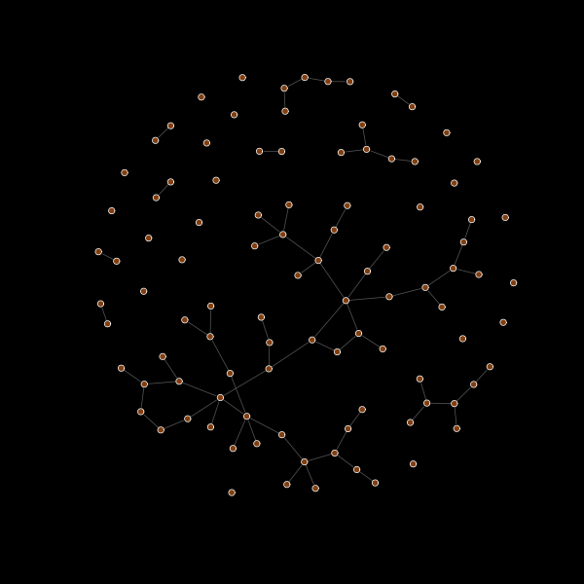
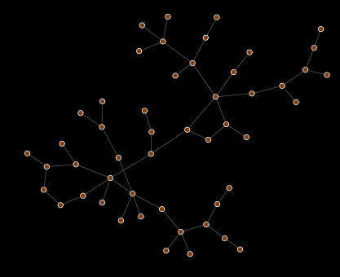
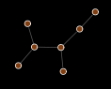
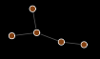
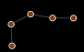
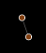
Extracting connected components

Slide 36
Community Detection Step
Dataset
N snippets
Features
NxM values
Similarity Graph
N nodes
Connected
Components
Clone
Communities

Slide 37
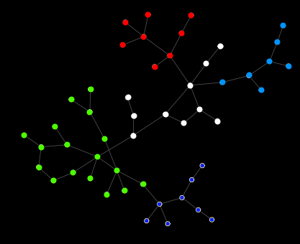
Applying community detection

Slide 38
Public Git Archive
182,014 projects (repos on GitHub with over 50 stars)
3 TB of code
Commit history included
PGA HEAD = ~54.5 million files
With Babelfish driver = ~14.1 million files

Slide 39
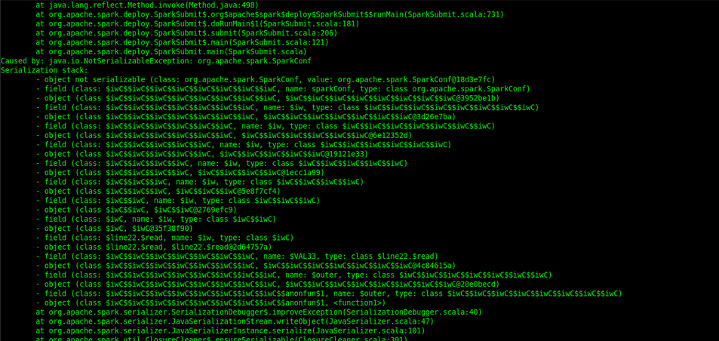

Slide 40
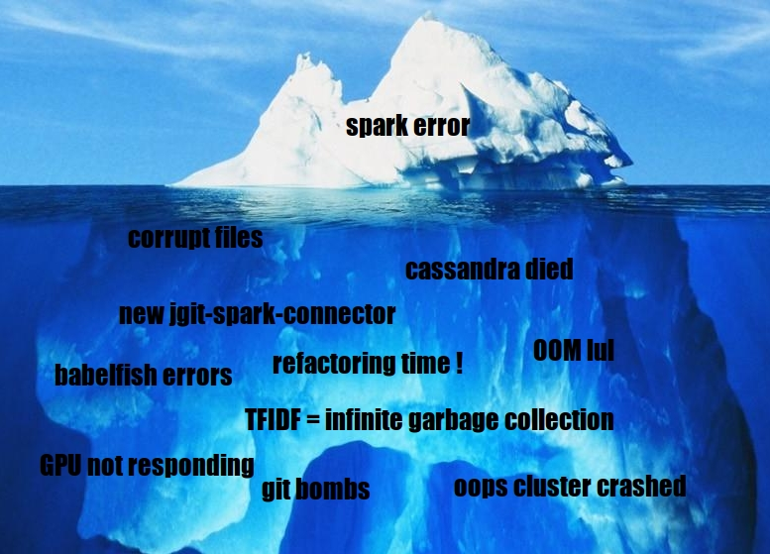

Slide 41
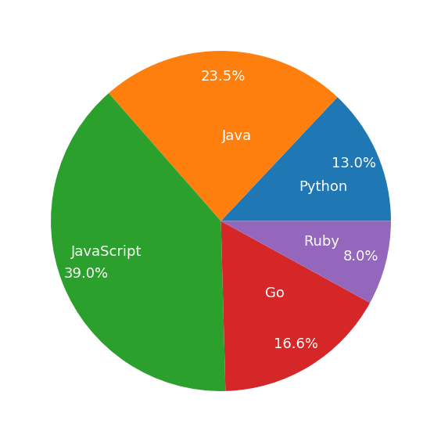
Post-feature extraction
7,869,917 million files processed
102,114 project
6,194,874 distinct features

Slide 42
Features analysis
Feature distribution:
identifiers: 9.93 %
literals: 65.7 %
graphlets: 11.84 %
children: 0.02 %
uast2seq (DFS) : 10.49%
node2vec (random walk) : 2.02 %

Slide 43
Features analysis
Average number of features per file:
60 identifiers
38 literals
116 graphlets
37 children
336 uast2seq (DFS)
460 node2vec (random walk)

Slide 44
Connected components analysis
95 % threshold:
4,270,967 CCs
52.4 % of files in CCs with > 1 file
7.83 file per CC with > 1 file
80 % threshold:
3,551,648 CCs
61.9 % of files in CCs with > 1 file
8.79 file per CC with > 1 file

Slide 45
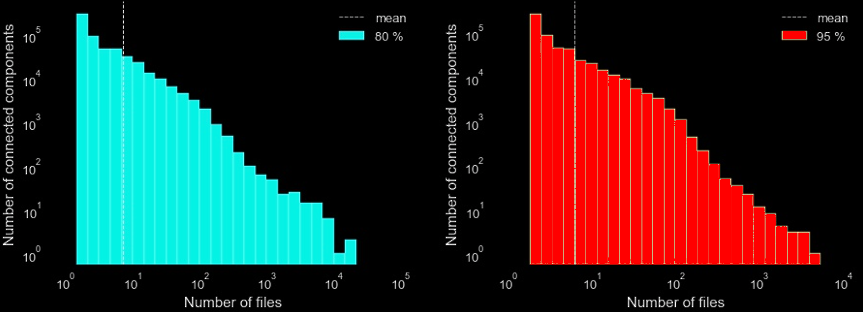
Connected components analysis

Slide 46
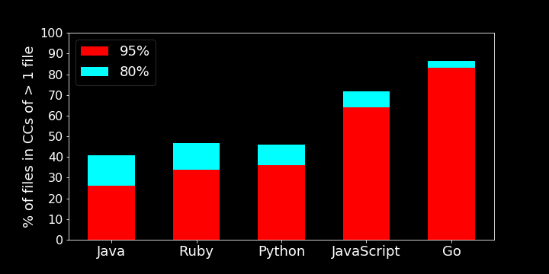
Connected components analysis
3,551,648

Slide 47
Communities analysis
Detection done with Walktrap algorithm
95 % threshold:
526,715 CCs with > 1 file
In those, we detected 666,692 communities
80 % threshold:
553,997 CCs with > 1 file
In those, we detected 918,333 communities

Slide 48
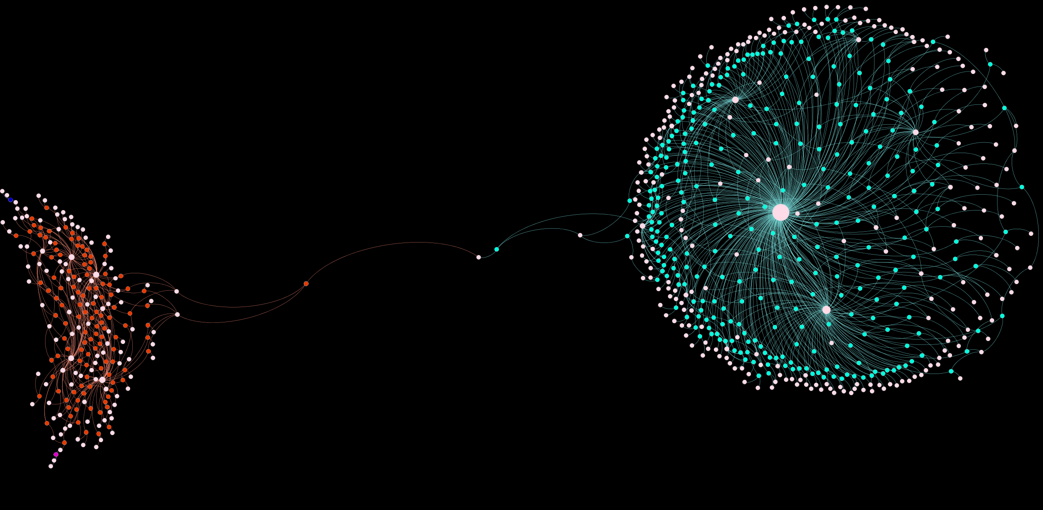
text_parser.go
422 files - 327 projects - 1 filename

Slide 49
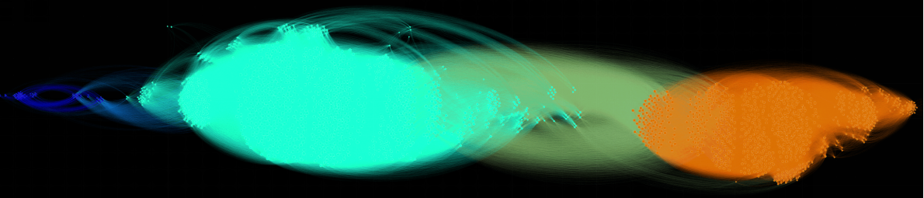
filenames
2344 files - 1058 projects - 584 filename

Slide 50
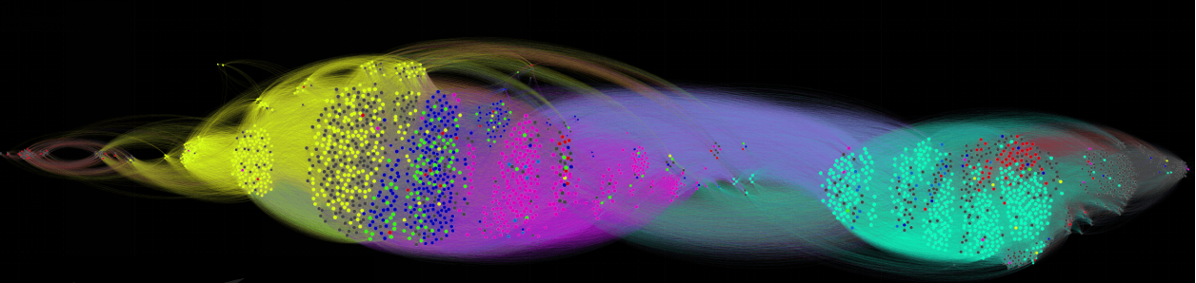
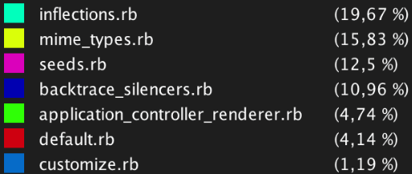
filenames

Slide 51
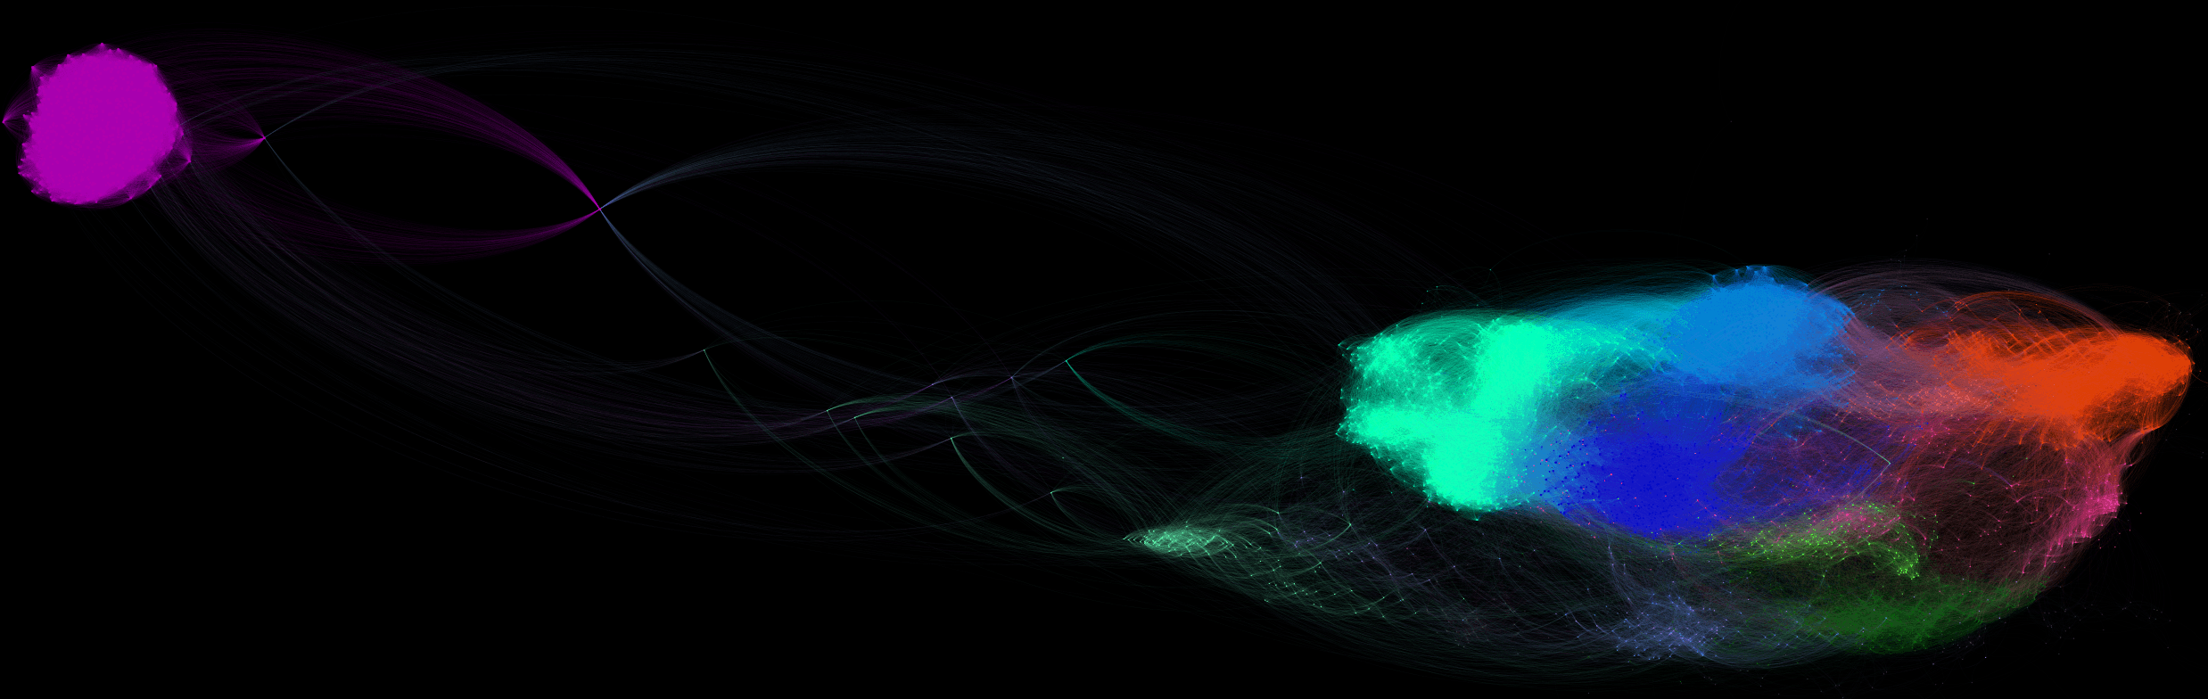
Microsoft Azure SDK
4803 files - 3 projects - 2954 filename

Slide 52
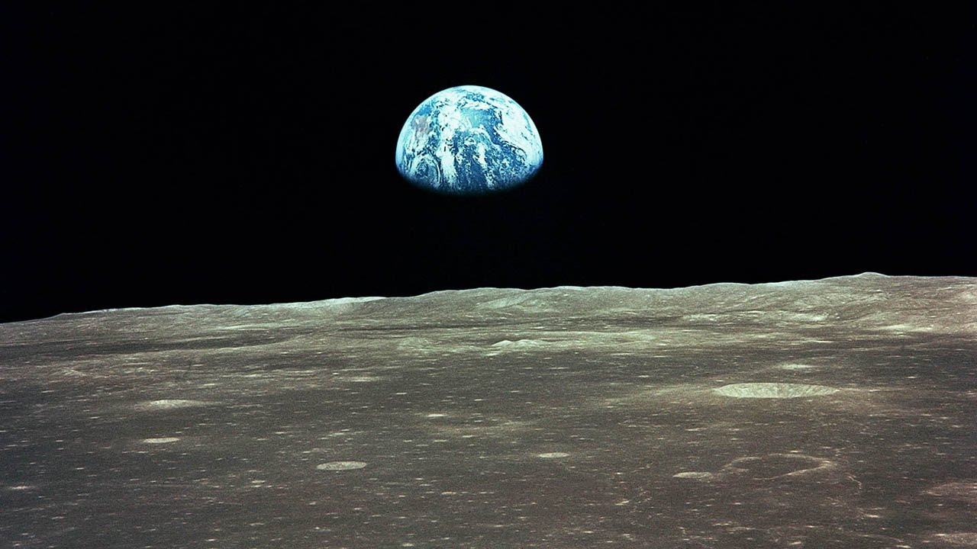
Thank you !
For more:
blog.sourced.tech/post/deduplicating_pga_with_apollo
github.com/src-d/gemini
pga.sourced.tech/
r.keramitas@gmail.com

